Slide 1
Digital-Logic
Final-Project
By Imer Lopez

Slide 2
TABLE OF CONTENTS
Review Soda Machine Dispenser Problem
FSM
State Encoding Table
State Transitions Table And Equations
Output Equations
Circuit Diagram
Final Remarks

Slide 3
Soda Machine Dispenser Problem
You have been enlisted to design a soda machine dispenser for the IT department students' lounge. Sodas are partially subsidized by the student chapter of the ACM, so they cost only 25 cents each.
The machine accepts 5 cents, 10 cents, and shillings.
When enough coins have been inserted, it dispenses the soda and returns any
necessary change. Design an FSM controller for the soda machine.
The FSM inputs are 5 cent, 10 cent, and shilling, indicating which coin was inserted. Assume that
exactly ONE coin is inserted on each cycle.
The outputs are Dispense, Return5Cents,
Return10Cents, and ReturnTwo10Cents.
When the FSM reaches 25 cents, it asserts
Dispense and the necessary Return outputs required to deliver the appropriate change.
Then it should be ready to start accepting coins for another soda.

Slide 4
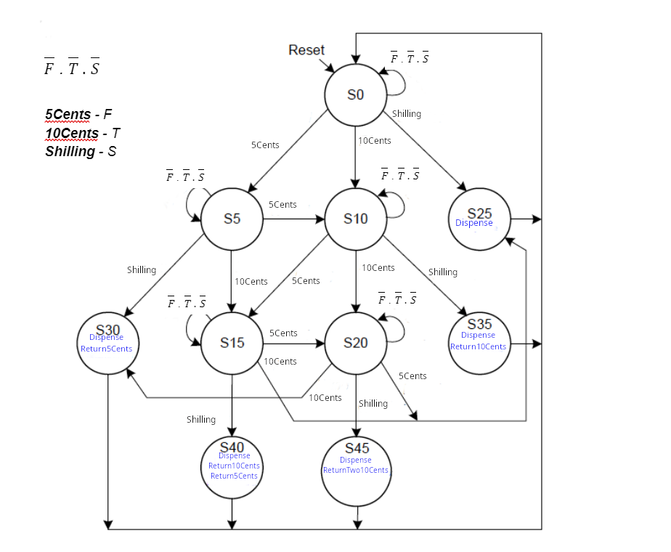
FSM
Inputs:
5 Cents
10 Cents
Shillings
Outputs:
Dispense
Return5Cents
Return10Cents
ReturnTwo10Cent
A Soda is dispense when the machine has reach 25 cents

Slide 5
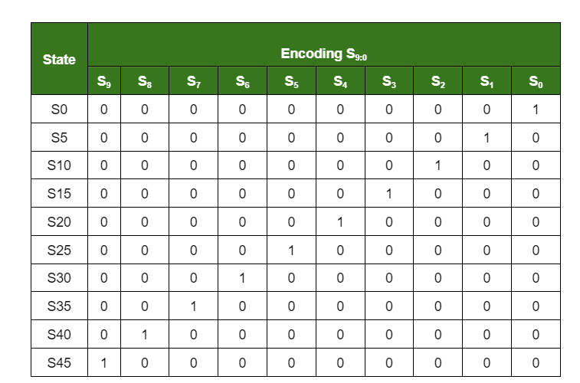
State Encoding Table
One-Hot Encoding

Slide 6
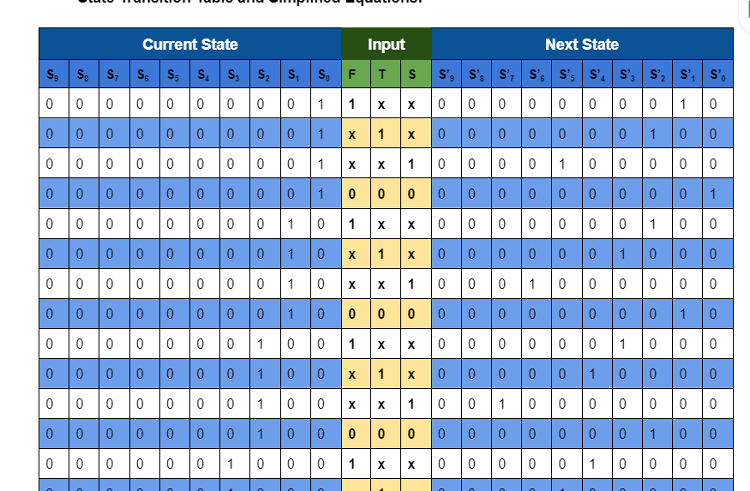
State Transition Table and Equations

Slide 7
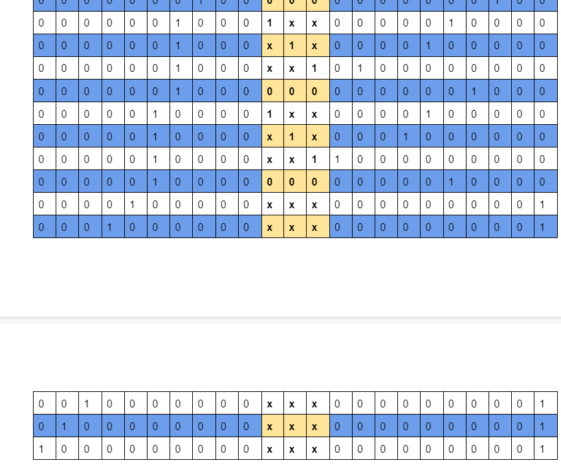
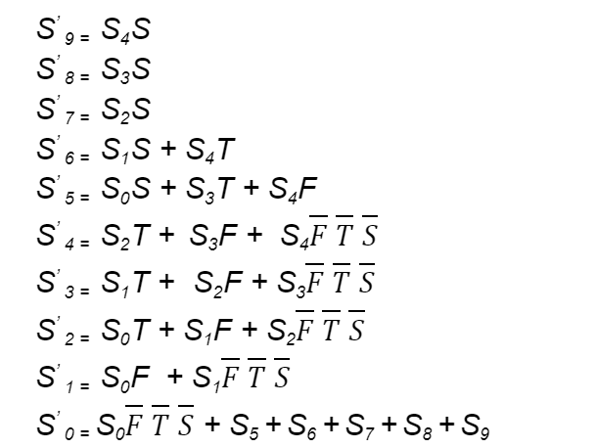
State Transition Table and Equations

Slide 8
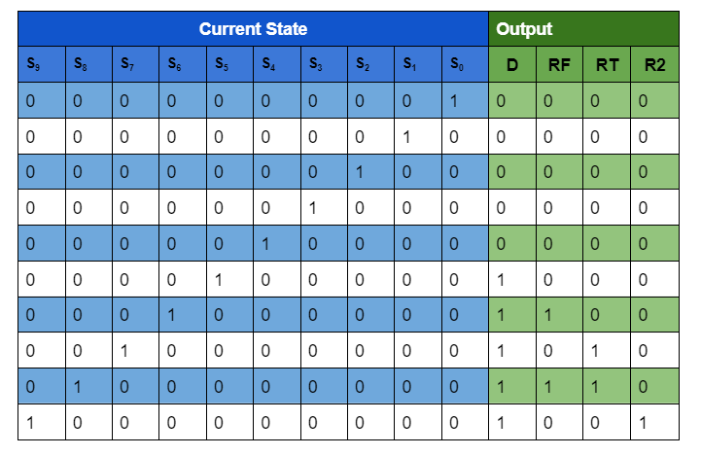
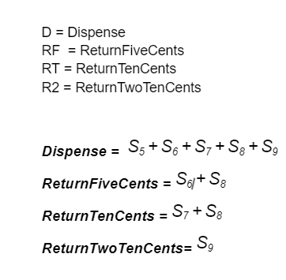
Output Table and Equations

Slide 9
Circuit Diagram
Demo

Slide 10
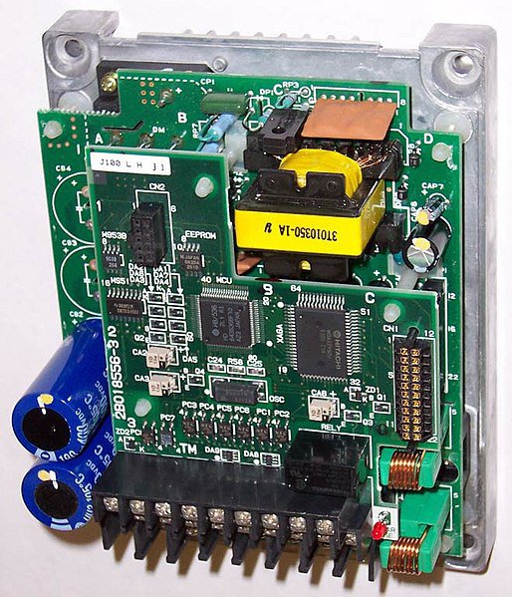
Final Remarks
Learning Outcomes
Model Problems with FSM
Generate State Transition Table
Generate Output Table
Simplified Equation from Tables
Generate Circuit from Simplified Equations

Slide 11
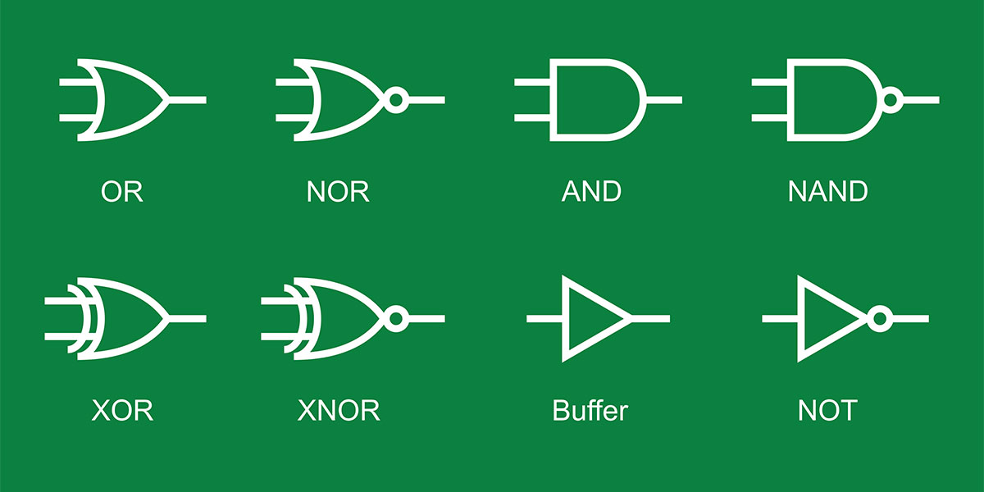
THANKS!

